Slide 1
Introduction to GitHub for Researchers
Alex Mielke

Slide 2
Structure
What do reproducible workflows look like?
Example of how Github can help with that
What is Git?
Different ways of using Github
Git terminology and basics
Using Github for your own projects
Use Github for collaborations
Troubleshooting
Github in RStudio

Slide 3

A lot of resources
I will collect some of them on the Github page and after put them on Sharepoint
Society for Open, Reliable and Transparent Ecology and Evolutionary Biology: https://www.sortee.org/

Slide 4
Reproducibility
‘A second investigator (including the original researcher in the future) can recreate the final reported results of the project, including key quantitative findings, tables, and figures, given only a set of files and written instructions.’ (Kitzes et al. 2017)
Literally: If you gave your raw data and all your documentation to someone, would they arrive at the same conclusion
Single best way to prevent fraud, errors, and create research integrity
Journals have started using Data Editors

Slide 5
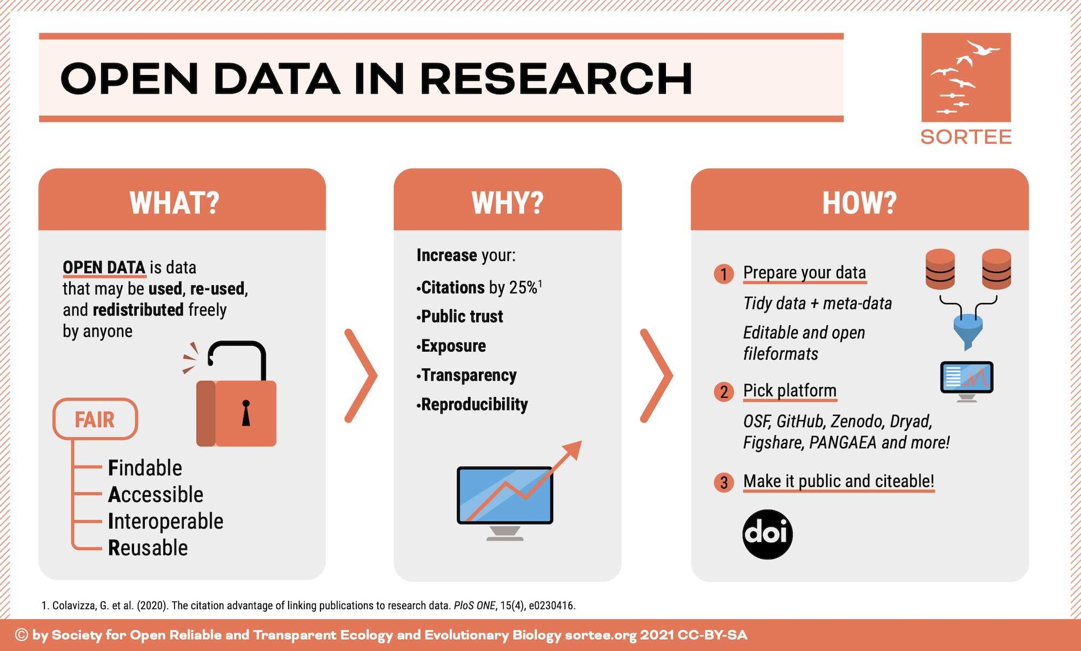
Why should we implement open data and code?

Slide 6
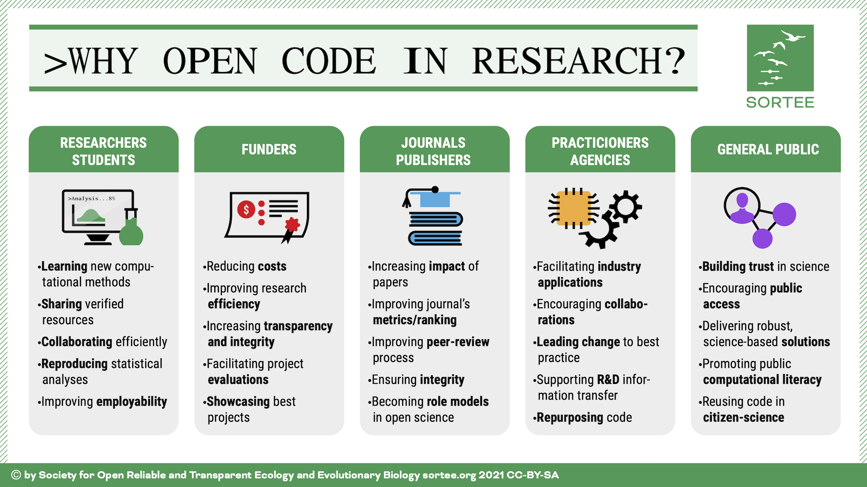
Why should we implement open data and code?

Slide 7
Quality and ethical issue
‘Militant’ opinion: if the public gives you money to do science, the data should be publicly available
Allows quality control and actual progress

Slide 8
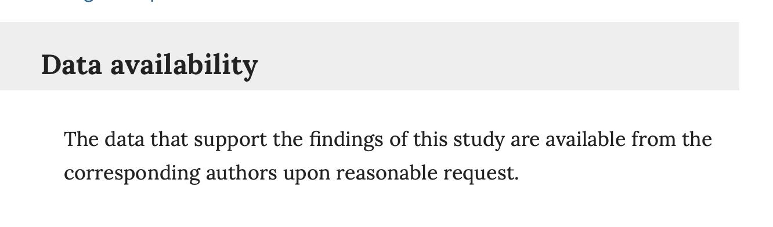
Does it currently work?

Slide 9
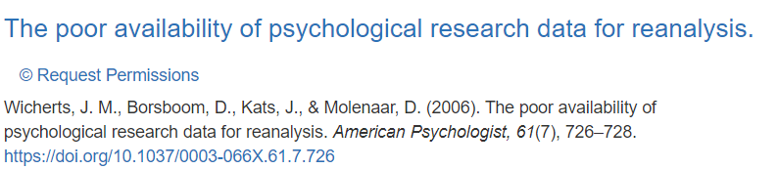
Does it currently work?
Only ~25% of authors shared data upon request

Slide 10
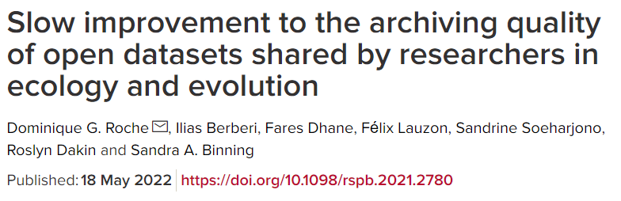
Only ~50% of open datasets were actually reusable

Slide 11
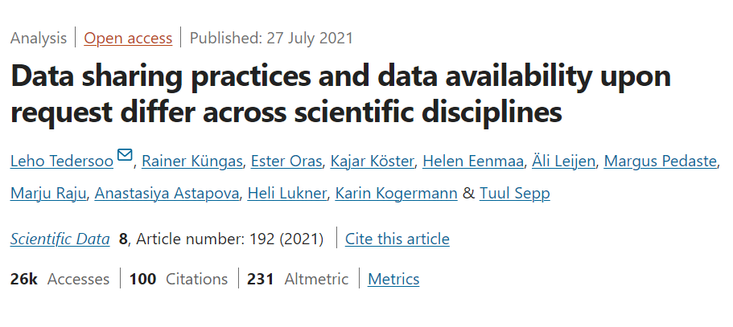
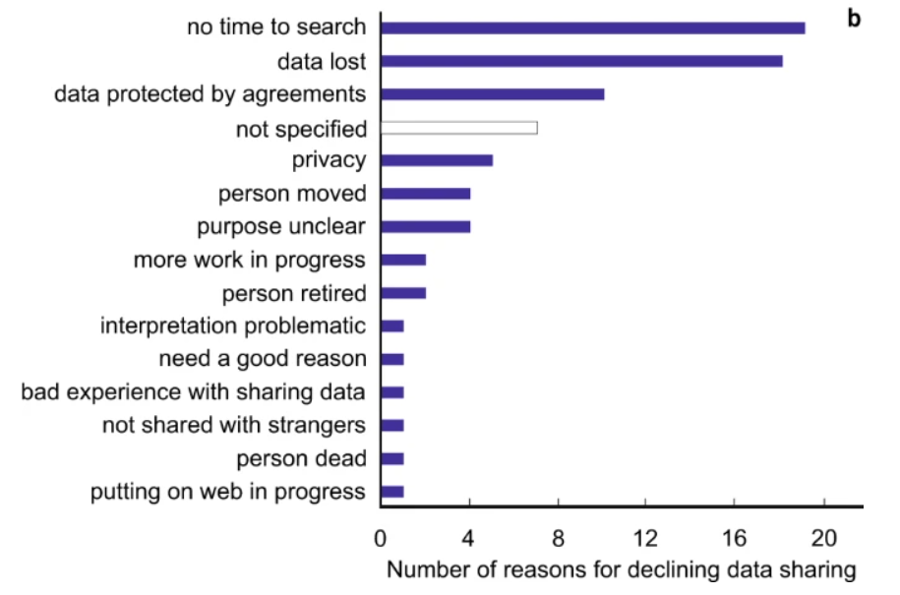
Why didn’t researchers share data?

Slide 12
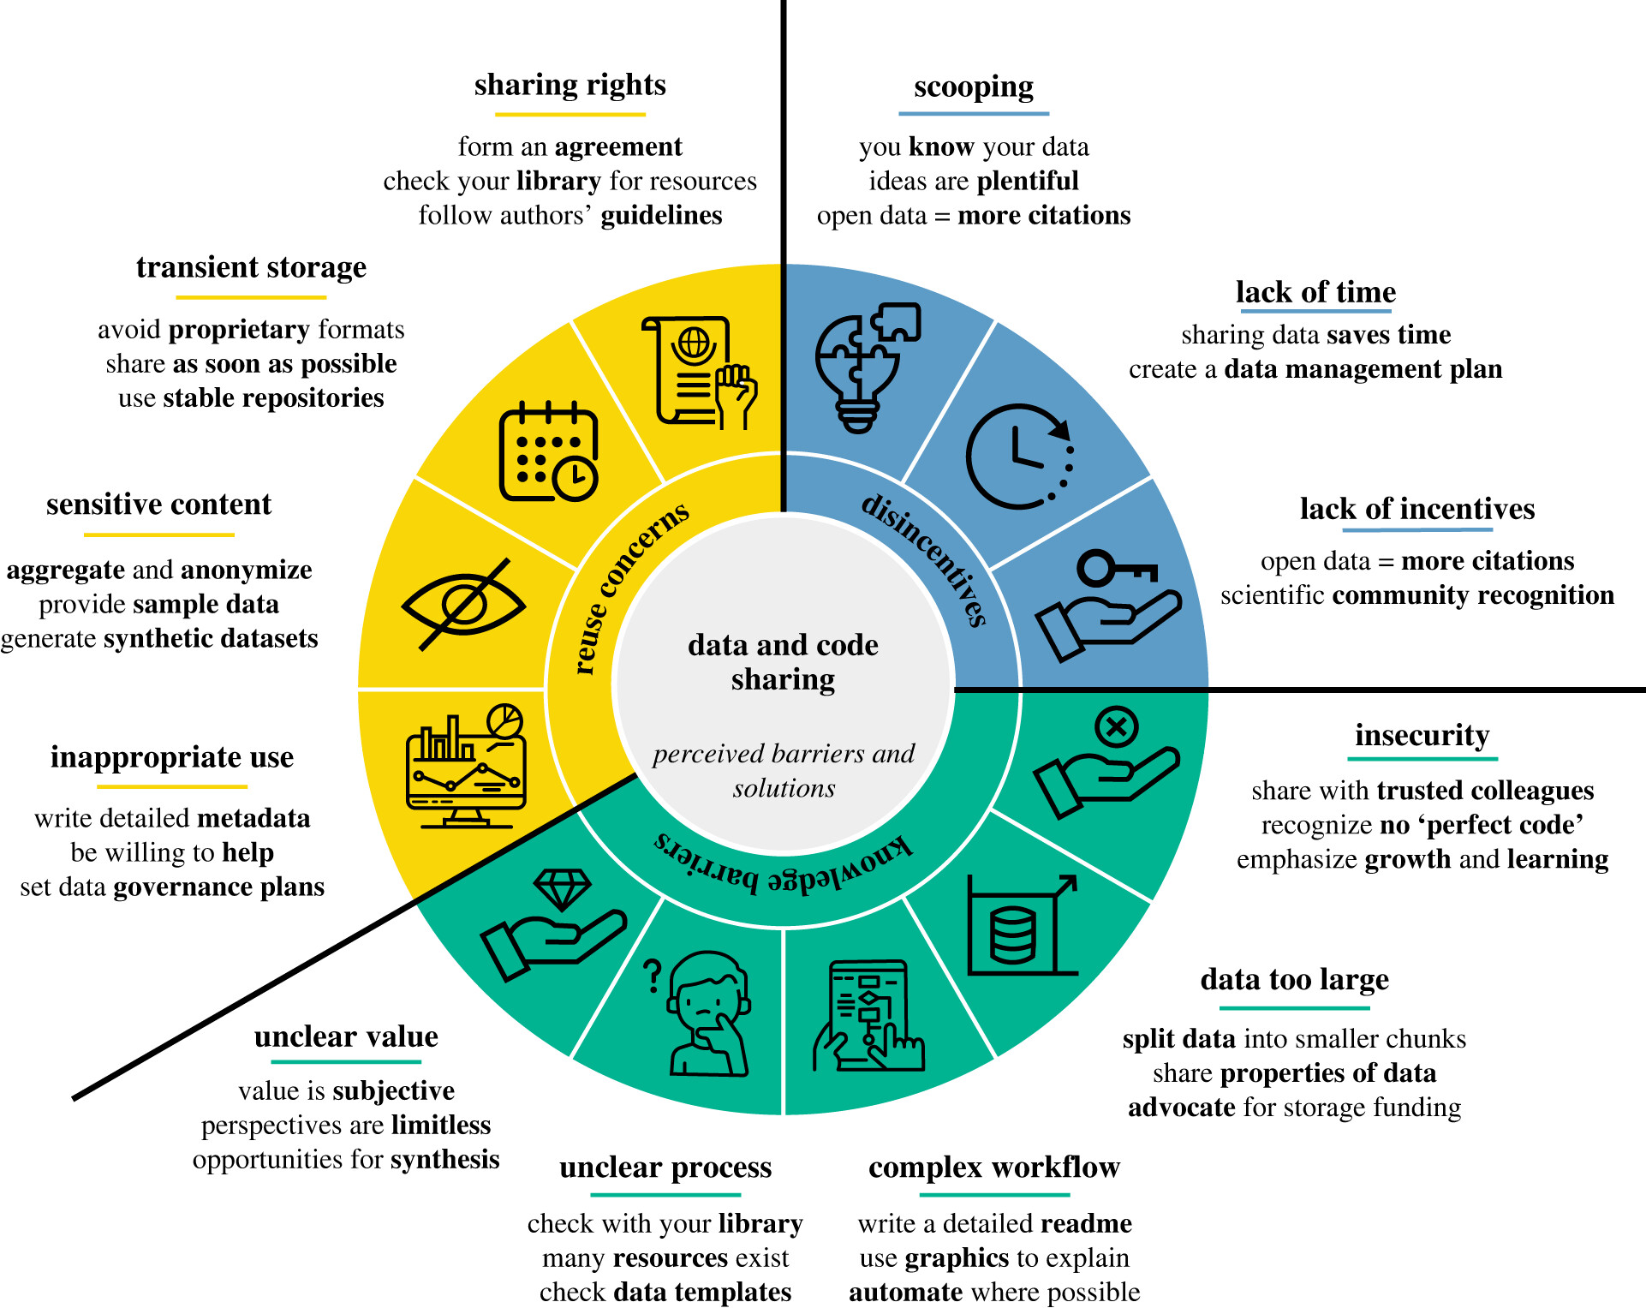
https://doi.org/10.1098/rspb.2022.1113

Slide 13
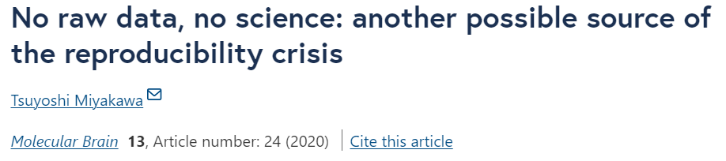
Editor-in-Chief of Molecular Brain
40/41 papers that were accepted with the provision that raw data are shared withdrew the paper or provided insufficient data
‘Thus, more than 97% of the 41 manuscripts did not present the raw data supporting their results when requested by an editor, suggesting a possibility that the raw data did not exist from the beginning, at least in some portions of these cases.’

Slide 14
x

Slide 15




Raw Data to Publication Reproducibility
Create a data ecosystem where all processing steps are transparent and any user can reproduce every step of the workflow
All data are accessible at the earliest possible stage to increase long-term impact and transparency
Raw data (anonymized)
All processing steps
Analysis
Available for review and after publication

Slide 16
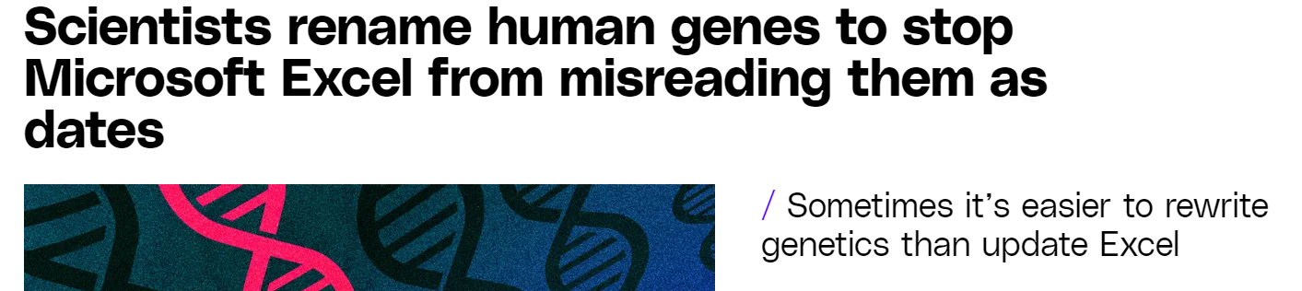
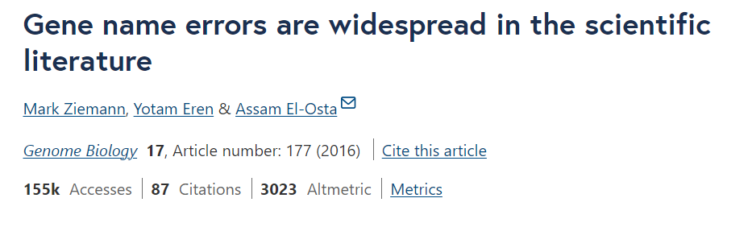
Why raw data?
~1/5 published genetics papers had Excel errors

Slide 17
Why all processing steps?
Many Analyst studies -> Hidden variation in processing steps
Just finished one for primatology – raw data to final analysis of social system
Out of 40 experienced researchers, 0 found all ‘true’ effects in the simulated data, and no 2 researchers used the same processing/analysis
Published literature: different papers are potentially not comparable unless we can redo the same processing steps

Slide 18
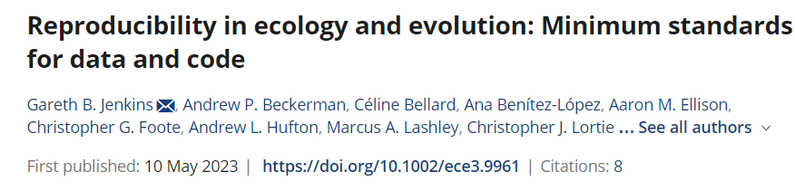
Raw Data to Publication Reproducibility

Slide 19
Raw Data to Publication
Detailed metadata, describing relevant details about data collection, processing, analysis and presentation
Organized and clearly labeled data tables and files
Clearly outlined steps for data processing
All associated programming scripts, software, and code required to run any analyses used in the study
Clear and consistent file naming
References to other data, where applicable. Primary data should be included, secondary data cited
Clearly stated license under which the data are distributed (e.g., Creative Commons)

Slide 20
Exemptions
Sensitive human data
Endangered species
Long-term research data
Indigenous recognition

Slide 21
Questions? Comments?

Slide 22
An example of my workflow
https://github.com/AlexMielke1988/Mielke-Carvalho_Chimpanzee-Play

Slide 23
Questions? Comments?

Slide 24
What is Git?
Git is a version control system
Tracks changes to files
Lets users see what changes were made, when, by whom, and why
Allows you to revert back to previous versions

Slide 25

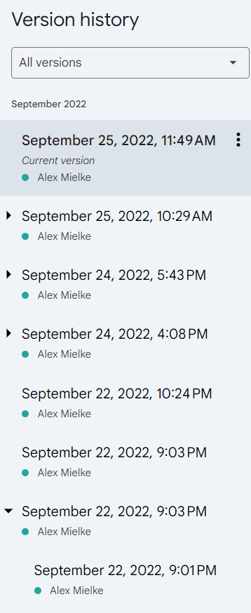

Slide 26
What is Git?
Git is a version control system
Tracks changes to files
Lets users see what changes were made, when, by whom, and why
Allows you to revert back to previous versions
Version control for all different data types and code

Slide 27
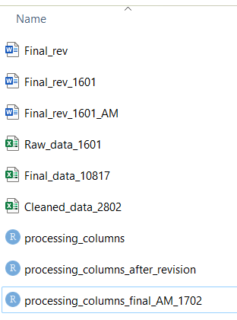
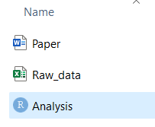
What is Git?
Multiple simultaneous users
Your mess

Slide 28
What is Git?
Git is a version control system
Tracks changes to files
Lets users see what changes were made, when, by whom, and why
Allows you to revert back to previous versions
Version control for all different data types and code
Github is to Git what RStudio is to R – one of many User Interfaces to facilitate use

Slide 29
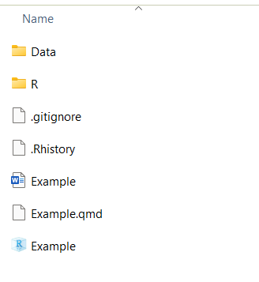
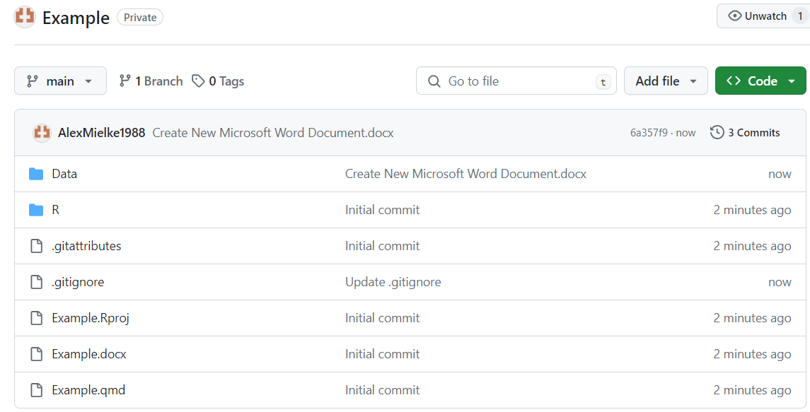
Ways to use GitHub
‘Dropbox with accountability’ – One user, potentially multiple machines, backup your project and organize your files, private

Slide 30
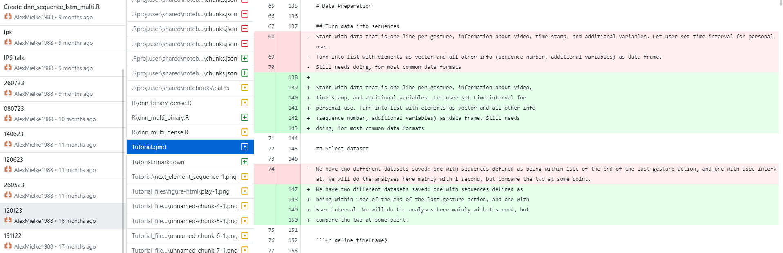

Slide 31
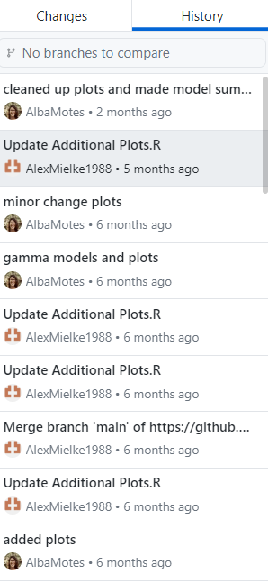
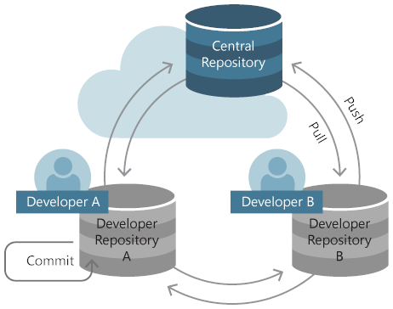
Ways to use GitHub
Collaboration – Multiple user, backup project and track changes, work on files simultaneously and integrate changes, private

Slide 32
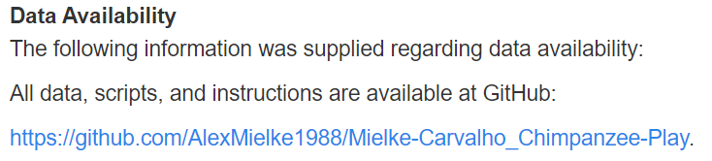
Ways to use GitHub
Publication record – Public record of all (anonymized) raw data, processing steps, and analysis
Raw data (anonymized)
All processing steps
Analysis
Available for review and after publication

Slide 33
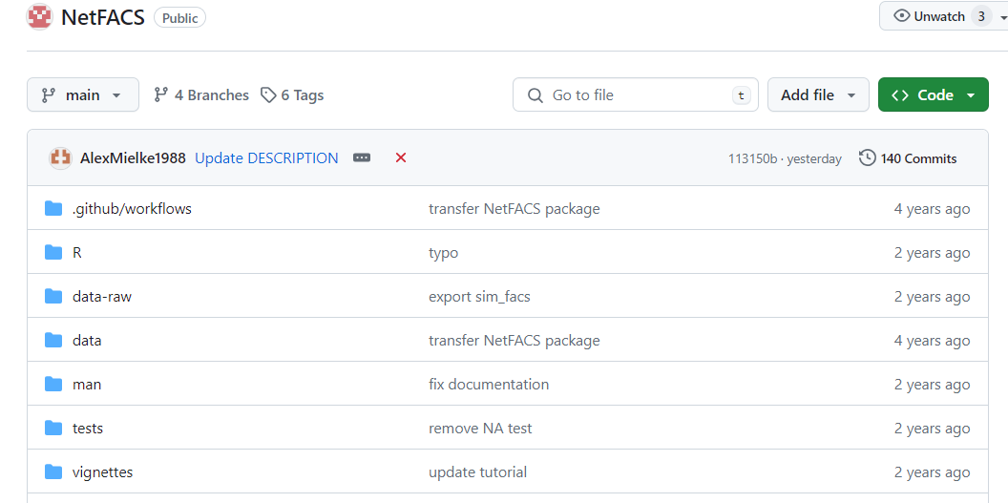
Ways to use GitHub
R Package repository – dump scripts that are useful but do not yet belong on CRAN

Slide 34
Questions? Comments?

Slide 35
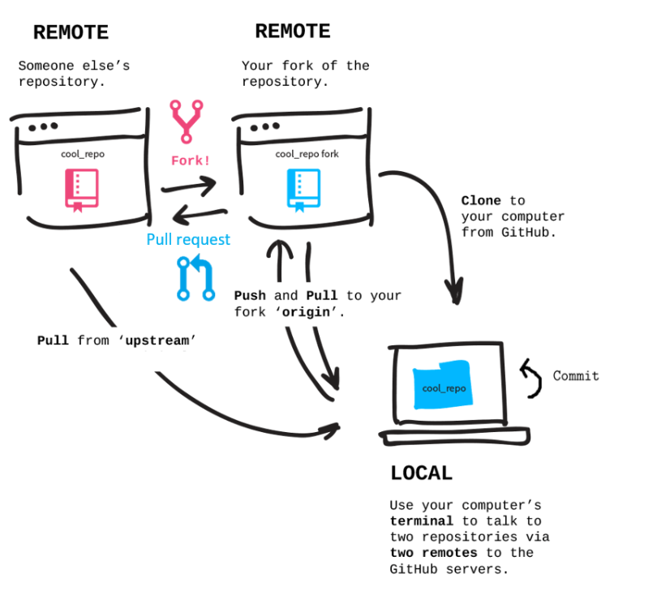
Git Terminology
https://lmu-osc.github.io/Collaborative-RStudio-GitHub/

Slide 36
Git Terminology
https://lmu-osc.github.io/Collaborative-RStudio-GitHub/
Repository: Folder that files are organized it

Slide 37
Git Terminology
https://lmu-osc.github.io/Collaborative-RStudio-GitHub/
Fork: create a version of a collaborators Repository on your own Github account

Slide 38











Git Terminology
https://lmu-osc.github.io/Collaborative-RStudio-GitHub/
Clone: create a version of a Repository on your local machine

Slide 39


Git Terminology
https://lmu-osc.github.io/Collaborative-RStudio-GitHub/
Commit: make a change on your local machine and tell Github that it should be added to the remote Repository

Slide 40


Git Terminology
https://lmu-osc.github.io/Collaborative-RStudio-GitHub/
Push: Send your changes to the remote Repository
Pull: Download updates that were made to the Repository

Slide 41

Git Terminology
https://lmu-osc.github.io/Collaborative-RStudio-GitHub/
Pull request: Tell the owner of the original repository that you have made changes, allowing them to merge the files

Slide 42
Git Terminology
https://lmu-osc.github.io/Collaborative-RStudio-GitHub/
Pull from ‘upstream’: get all the changes any collaborator has made to the original repository

Slide 43
Questions? Comments?

Slide 44
Using Github as a backup for your own projects

Slide 45
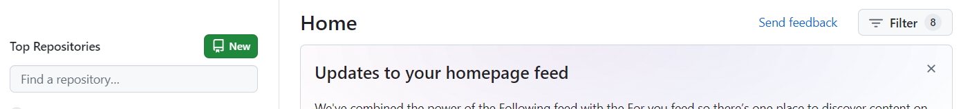

Creating your own repository
Go to https://github.com/ and log in
Switch back and forth between Github Online and Desktop

Slide 46
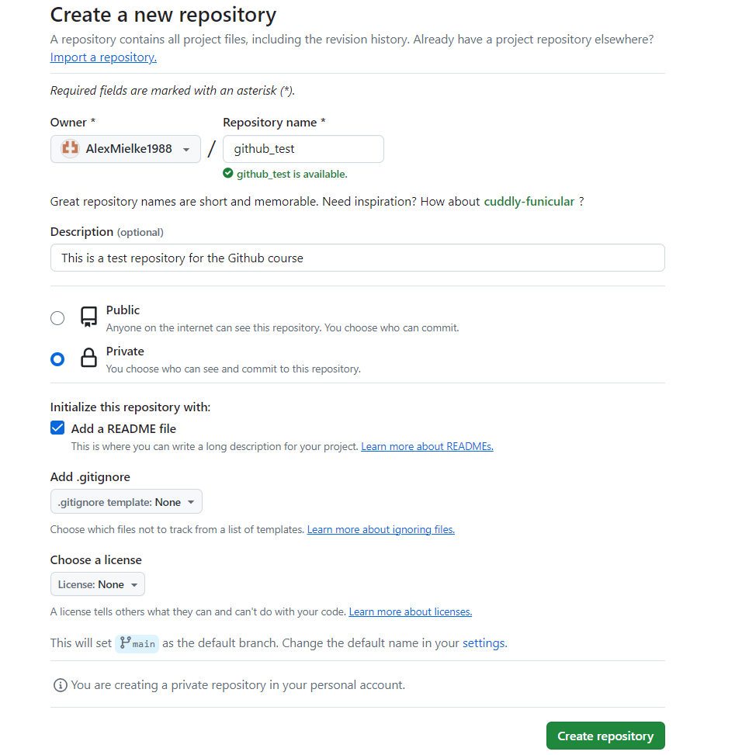

Slide 47
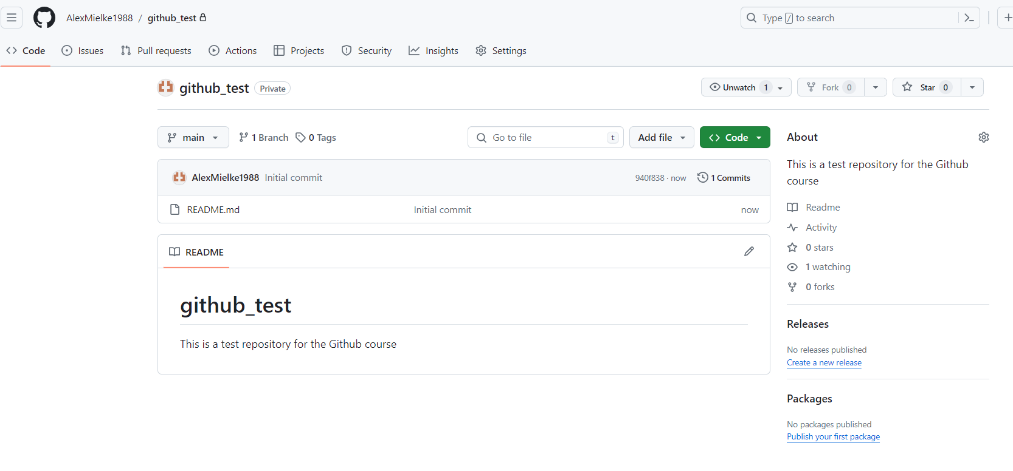

Slide 48
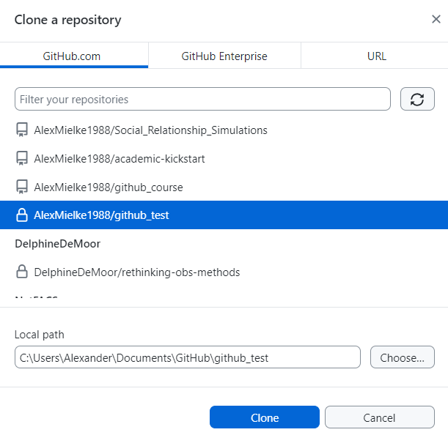
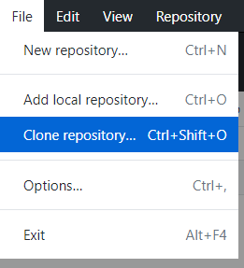

Open Github Desktop App

Slide 49
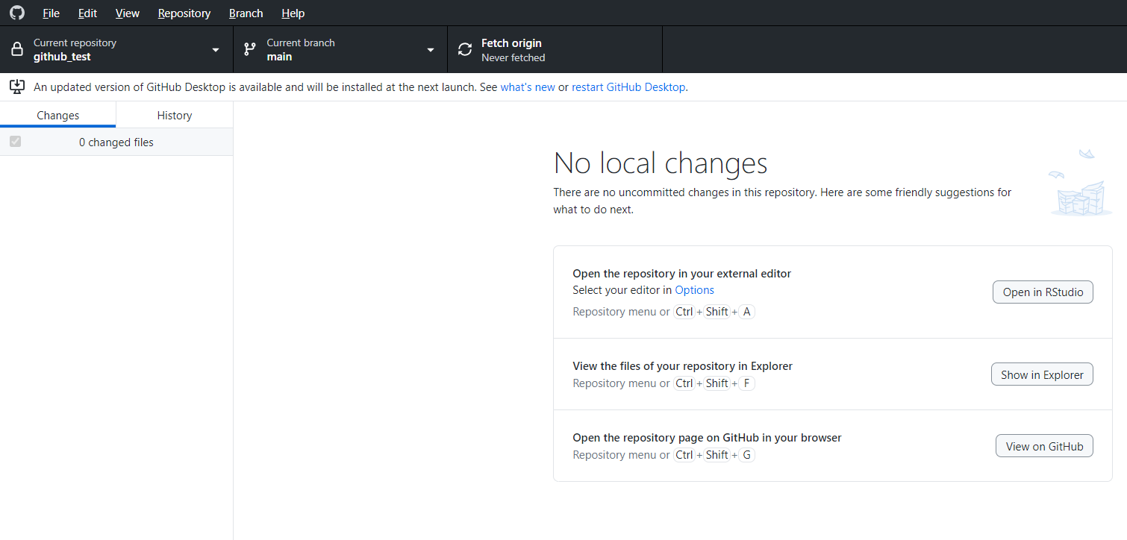




Slide 50
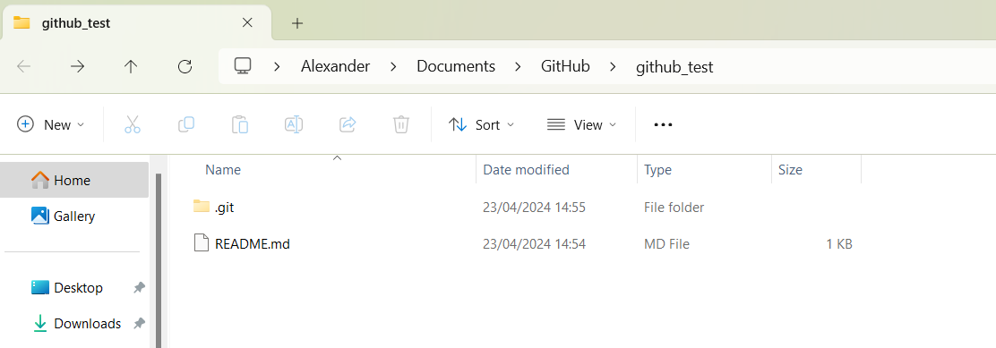

Slide 51
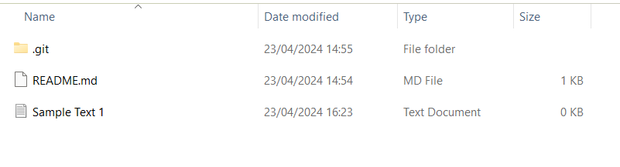
Create a new text file

Slide 52
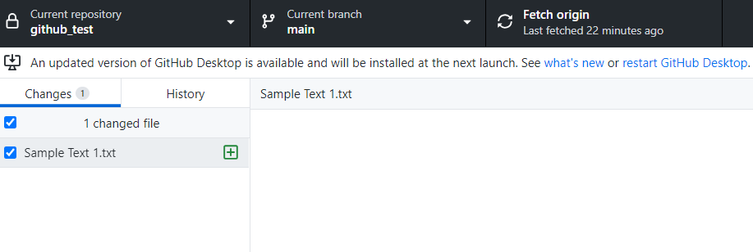
New file has now appeared in Github Desktop
Can decide whether to push it or not by clicking the box

Slide 53
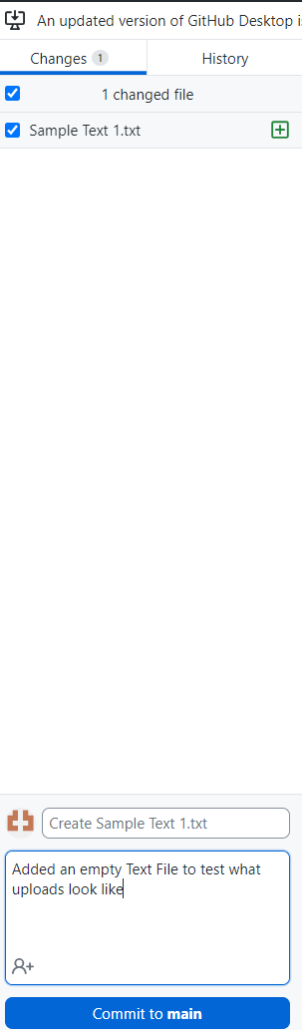
Make them informative!
Title the change will have in the Github history afterwards
Short description to let your collaborators or future you know what you did

Slide 54
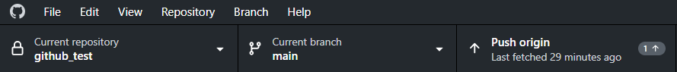
Push your commits online

Slide 55
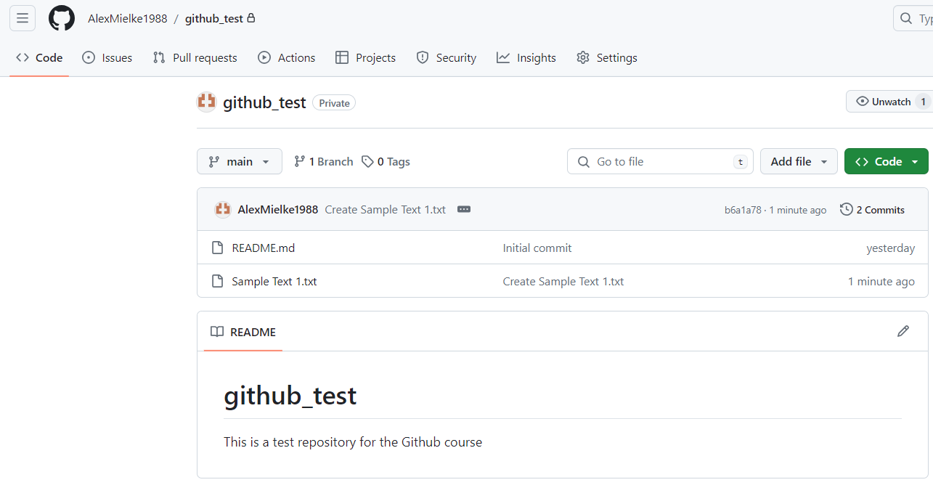

Slide 56
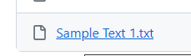
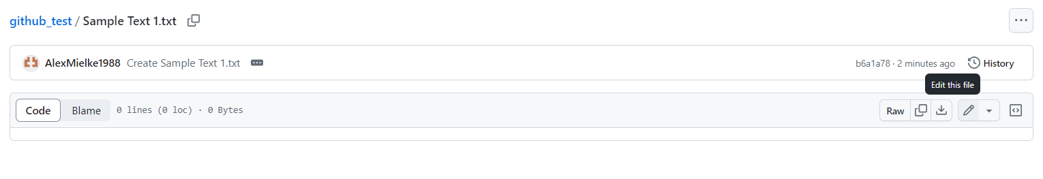
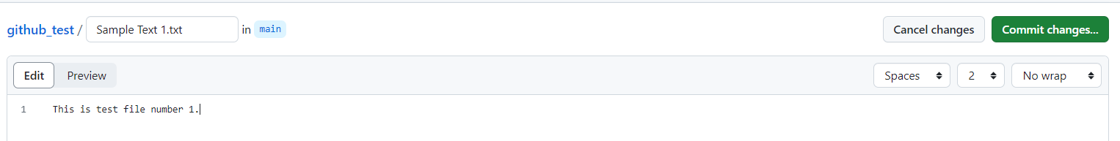
Click on the text file in Github Online
Edit the file by clicking on the little pencil
Write some text and click ‘Commit Changes’

Slide 57
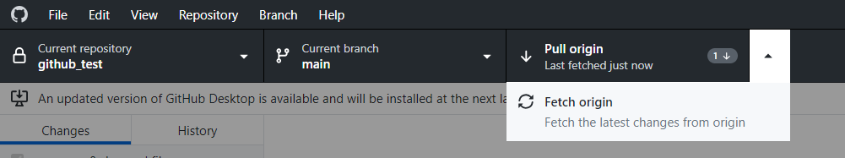
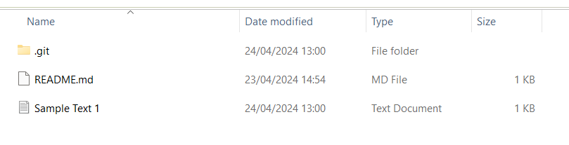
Click on the text file in Github Desktop, click Fetch origin (checks for changes) and then Pull origin (downloads changes)
Open the text file in the project folder. The changes should have been made here as well.

Slide 58
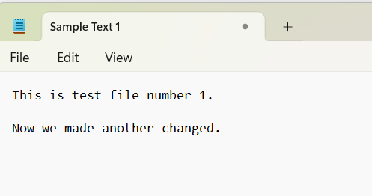
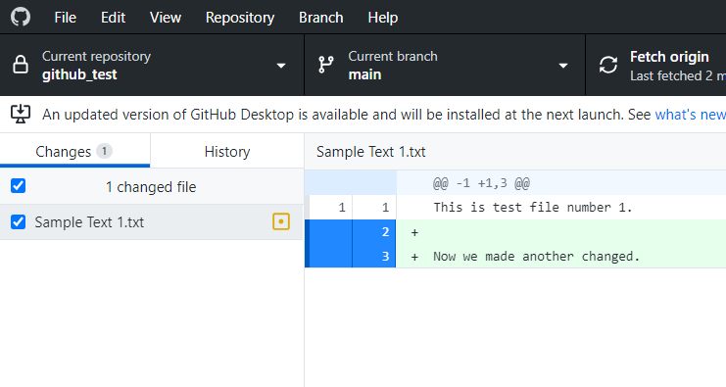
Add another line here and save.
Github now tells you how your local file differs from the one online

Slide 59
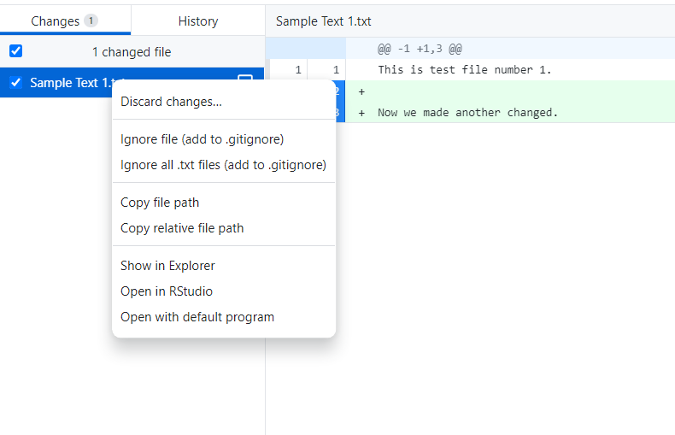

If you right-click on the file, you can revert it back to the state it has online.

Slide 60
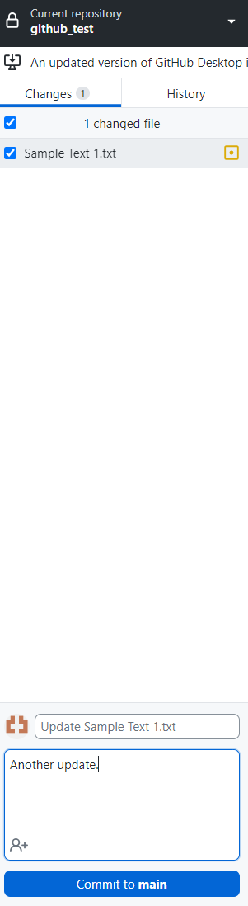
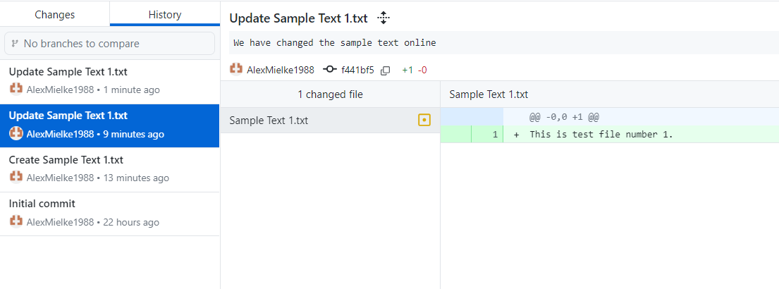
Commit this change and push it.
The History tab keeps a complete record of all the changes

Slide 61
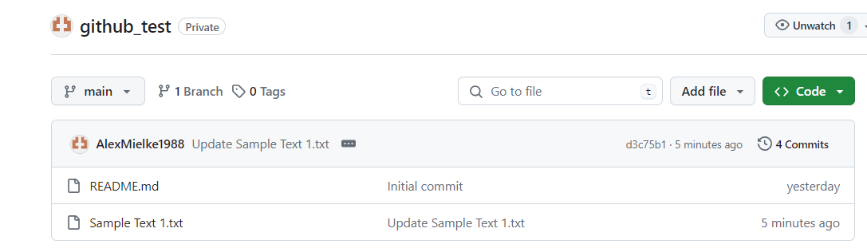





Slide 62
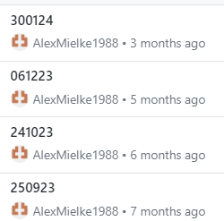


Rince and repeat to have a controlled project folder
Optimally have one of each file to keep the folder clean
Have the same structure for each project to save brain space
Commit regularly to have recent backups
When you work on multiple machines, make sure you commit and push on one machine before working on the same project on the other to avoid changing the same file on multiple machines
Make sure that you add useful information for each commit
Optimally, when you publish, this can be your repository

Slide 63
Questions? Comments?

Slide 64
Collaborating with Github

Slide 65
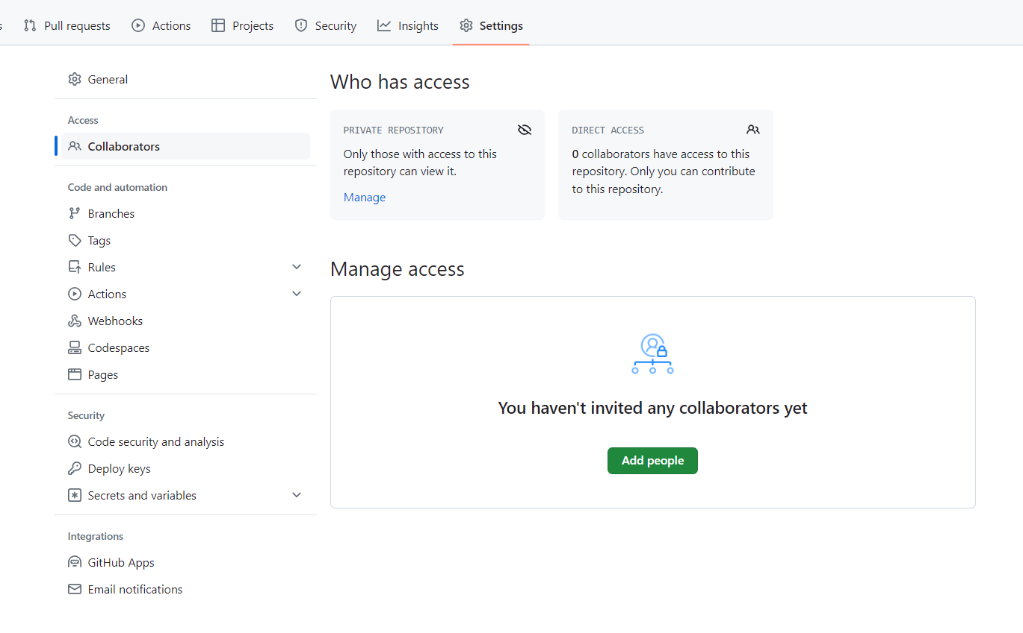




Slide 66
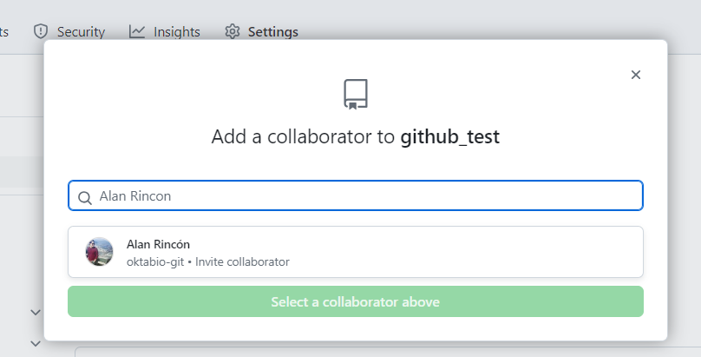

Slide 67
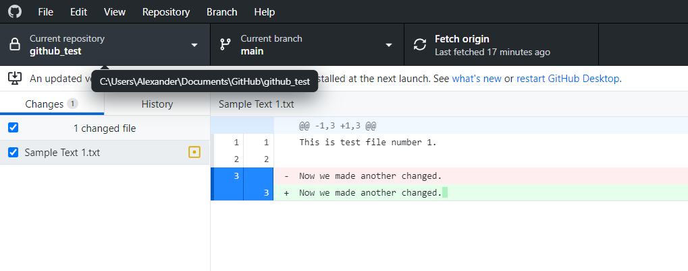




Slide 68



Clone repository creates a local version if you have access

Slide 69



Publicly open repo can be found in email I sent Tuesday

Slide 70



Slide 71

Create a new file in ‘Everyone’s Files’ with your name and push it
When everyone’s files are uploaded, pull them all

Slide 72




Branching

Slide 73


Slide 74


Slide 75


Slide 76


Slide 77




Slide 78
Questions? Comments?

Slide 79
Ways to use GitHub
Publication record – Public record of all (anonymized) raw data, processing steps, and analysis
Raw data (anonymized)
All processing steps
Analysis
Available for review and after publication
I usually create one clean repository specifically for the publication, with a commented Markdown file that lets the user follow all the steps I took
Alternatively, use the repository you have been working in from the start

Slide 80
Troubleshooting

Slide 81



Merge Conflict
Multiple users changed the same lines in the same file
Lets you go through and select the version you prefer

Slide 82



Raise Issues

Slide 83

Raise Issues

Slide 84
Questions? Comments?

Slide 85
Git in RStudio
You have to download Git! https://git-scm.com/downloads

Slide 86




Slide 87



Slide 88




Slide 89
Questions? Comments?

